Slide 1
Weakly supervised object localization
Thesis midterm – 15/2/2023
Geert Goemaere

Slide 2
Content
Introduction
Research question
Method
Experiments
Next steps

Slide 3
Introduction

Slide 4

Context: Object recognition tasks
WSOL
Multiple-instance WSOL
Notes:
The research topic of this thesis is called “multiple-instance weakly supervised object localization” (multiple-instance WSOL).
Let’s look at the picture to explain the topic in the field of object recognition tasks. From left to right we have:
Image classification deals with assigning a single label or category) to an image. Here the label is CAT.
Object localization deals with localizing objects in an image by indicating their bounding box. In the case of WSOL, only a single object is localized.
Object detection is the task of locating objects in an image with bounding boxes and assigning a class label for each detection.
Instance segmentation deals with assigning a class label for each pixel of an image.
In this project I will
assess the performance of specific WSOL methods for images with multiple object instances
Investigate mechanisms for those WSOL methods to improve localization of multiple object instances in images

Slide 5
Why WSOL?
Problem
Object detection achieves great performance, but …
… Requires costly human labelling of bounding boxes
Localization labels not always available or of poor quality
Solution
Weakly supervised: Only image-level labels are used to train model
Object localization based on learned features

Slide 6
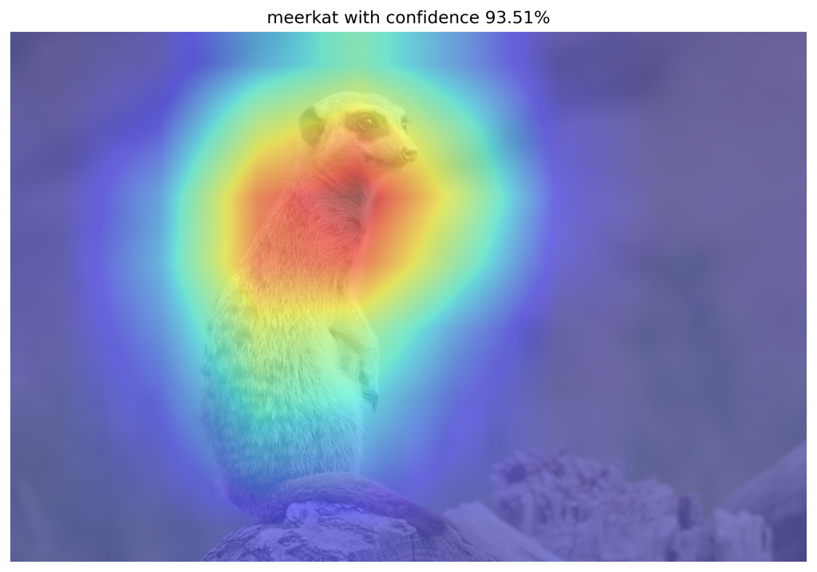
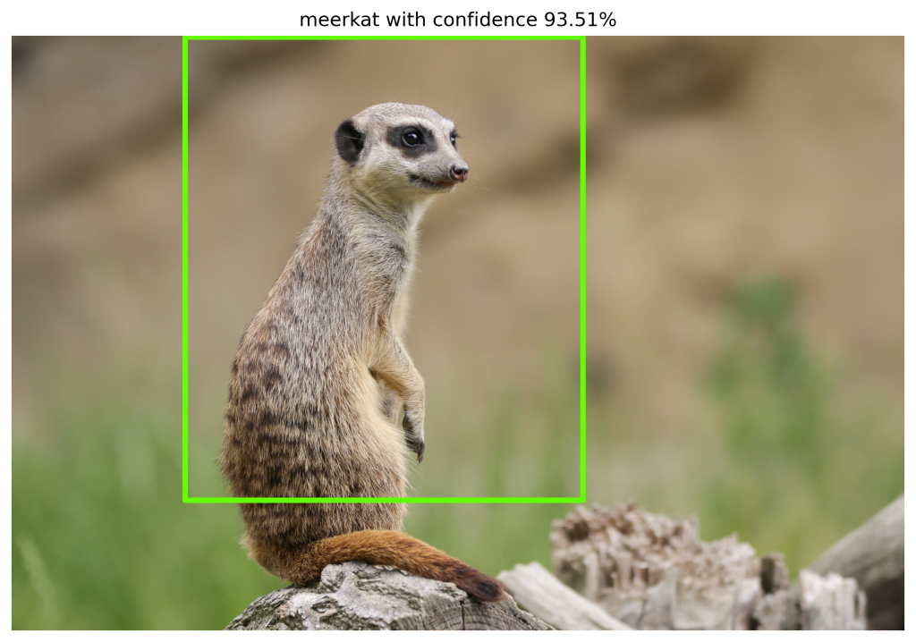
WSOL prior-art (deep learning)
Class Activation Mapping (CAM)
Baseline deep learning method of WSOL
Uses feature activations to localize objects
Limitations
Focus on discriminative parts of object: Object partly localized
Parts in background may activate and be recognized as object
CAM research
Use other techniques to overcome limitations
E.g. region regularization (MinMaxCAM), gradient-weighted CAM (GradCAM), score-weighted CAM (ScoreCAM).
Large field of research

Slide 7
Problems of WSOL
Inaccurate object coverage
CAM based on activations in higher layers
More related to object category
Loss of spatial accuracy due to lower resolution
Assumption of single object in image
Lacking evaluation protocol for multiple object instances
No prior-art for multiple instance WSOL!
Interesting to evaluate multi-instance WSOL

Slide 8
Research question
Can weakly supervised object localization using CAM-methods localize multiple instances of the same class?
Assess multiple-instance localization performance using specific CAM-methods
Investigate mechanisms to improve multiple-instance localization
This research
Define novel evaluation metrics for multiple-instance WSOL
Benchmark new metrics on specific CAM methods
Find improvements for multiple-instance localization

Slide 9
Method

Slide 10
Multiple-instance WSOL - Localization
Localization based on CAM methods
CAM
Baseline method requires specific CNN with GAP layer and modified FC layer
Typically suffers drop in classification performance due to modified architecture
GradCAM
Generalization of CAM that doesn’t require modified CNN architecture.
ScoreCAM
More promising to capture features of multiple instances than GradCAM
MinMaxCAM:
Improvement of object coverage by regularization of common object regions and background
Specific CNN architecture that requires retraining

Slide 11
Multiple-instance WSOL - Localization
VGG16
Tends to focus on discriminative features
Used in all relevant papers (CAM, GradCAM, ScoreCAM, MinMaxCAM)
Vanilla: ImageNet pre-trained network
GAP variant: Requires re-training
ResNet50
More recent than VGG16
Used in MinMaxCAM paper
Vanilla has GAP layer: Used for all CAM methods

Slide 12
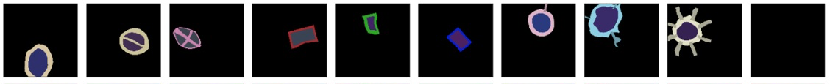

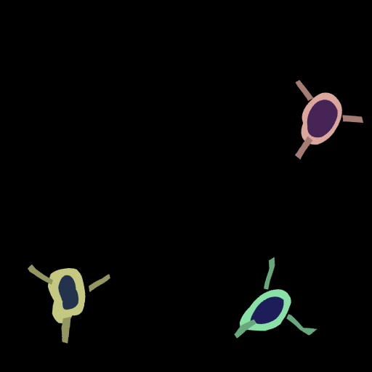
Multiple-instance WSOL – Datasets (Synthetic)
Synthetic datasets
9 classes
Image size: 512x512
Optional background
Ground truth labels
Segmentation masks for more accurate performance measurement
Bounding boxes for localization
Reference paper
Quantifying Explainability of Saliency Methods in Deep Neural Networks

Slide 13
Multiple-instance WSOL – Datasets (ImageNet-1k)
Used in all papers: CAM, Grad-CAM, ScoreCAM, MinMaxCAM
Ground-truth labels available for multi-instance WSOL
Single class label per image
Bounding boxes for all object instances in image (ILSVRC 2012)
Training set: 1.2M images
Propose to use subset of ImageNet-1k to limit computational requirements
Test set: 50k images
Use ImageNet-1k validation set as test set has no GT labels
Validation set: 10K images from ImageNetV2

Slide 14
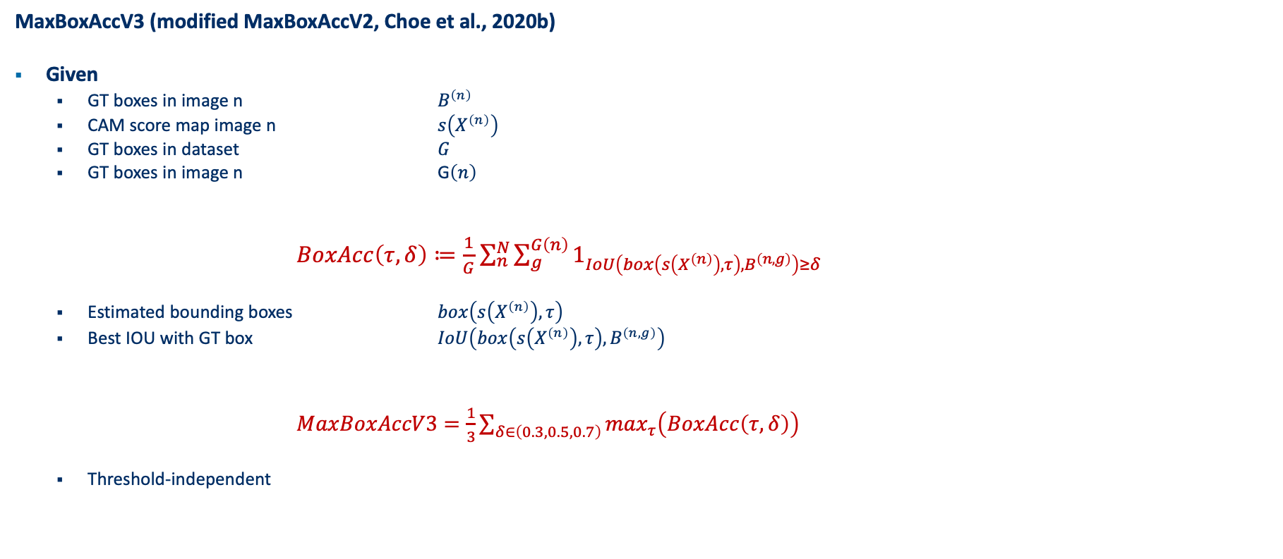
Multiple-instance WSOL - Metrics
MaxBoxAccV3 (modified MaxBoxAccV2, Choe et al., 2020b)
Given
GT boxes in image n $B^{\left(n\right)}$
CAM score map image n $s\left(X^{\left(n\right)}\right)$
GT boxes in dataset $G$
GT boxes in image n G$\left(n\right)$
$BoxAcc\left(τ,δ\right)≔\frac{1}{G}$ $\sum_{n}^{N}{\sum_{g}^{G\left(n\right)}{1_{IoU\left(box\left(s\left(X^{\left(n\right)}\right),τ\right),B^{\left(n,g\right)}\right)≥δ}}}$
Estimated bounding boxes $box\left(s\left(X^{\left(n\right)}\right),τ\right)$
Best IOU with GT box $IoU\left(box\left(s\left(X^{\left(n\right)}\right),τ\right),B^{\left(n,g\right)}\right)$
$MaxBoxAccV3=\frac{1}{3}\sum_{δ∈\left(0.3,0.5,0.7\right)}{\max_{τ}\left(BoxAcc\left(τ,δ\right)\right)}$
Threshold-independent

Slide 15
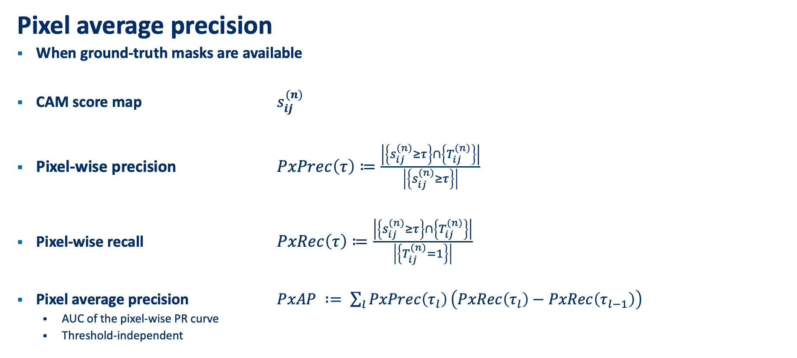
Multiple-instance WSOL - Metrics
Pixel average precision
When ground-truth masks are available
CAM score map $s_{ij}^{(n)}$
Pixel-wise precision $PxPrec\left(τ\right)≔\frac{\left|\left\{s_{ij}^{(n)}≥τ\right\}\right.∩\left.\left\{T_{ij}^{(n)}\right\}\right|}{\left|\left\{s_{ij}^{(n)}≥τ\right\}\right|}$
Pixel-wise recall $PxRec\left(τ\right)≔\frac{\left|\left\{s_{ij}^{(n)}≥τ\right\}\right.∩\left.\left\{T_{ij}^{(n)}\right\}\right|}{\left|\left\{T_{ij}^{(n)}=1\right\}\right|}$
Pixel average precision $PxAP ∶= \sum_{l}{PxPrec\left(τ_{l}\right)}\left(PxRec\left(τ_{l}\right)−PxRec\left(τ_{l−1}\right)\right)$
AUC of the pixel-wise PR curve
Threshold-independent

Slide 16
Multiple-instance WSOL - Improvements
Challenge
1 operational threshold to extract bounding boxes
Not all object instances of similar intensity
Proposal: Iterative bounding box extraction
Process
Bounding boxes with most intensity are extracted first with operational CAM threshold
Bounding boxes are masked (deleted, greyed, noise-filled) in CAM score map
Operational CAM threshold is lowered. Repeat 1.
Possible stop criterion:
No bounding boxes are found
Minimum CAM threshold reached.
Prediction score drop threshold reached when modified CAM score map fed to network.

Slide 17
Experiments

Slide 18
Next steps

Slide 19



